Slide 1

Pet Adoption Management System
CSYE 6200 Final Project - Group 2

Slide 2


Group Members
Shreyas Pogal Naveen
002201845
Ujwal Chandrashekar
002193079

Slide 3
Technology Stack
Backend: Java with Spring Boot
Frontend: React.js, HTML, CSS
Database: MongoDB
Logging: CSV files for listing's CRUD updates
IDE: Eclipse
Testing: Manual via UI & Console

Slide 4
OOD
Concepts
Abstraction
Model classes like User, Listing represent real-world entities
Encapsulation
Private fields with public getters/setters in all models
Inheritance
BaseEntity class extended by User, Listing, etc.
Polymorphism
Exportable interface used by Listing for CSV export

Slide 5
System Architecture
Three-layered architecture:
Model: User, Listing, Item, Enum
Controller: Auth, CRUD requests, endpoints for UI interaction and request flows.
MongoDB for data persistence
CSV Logger for tracking CRUD events

Slide 6
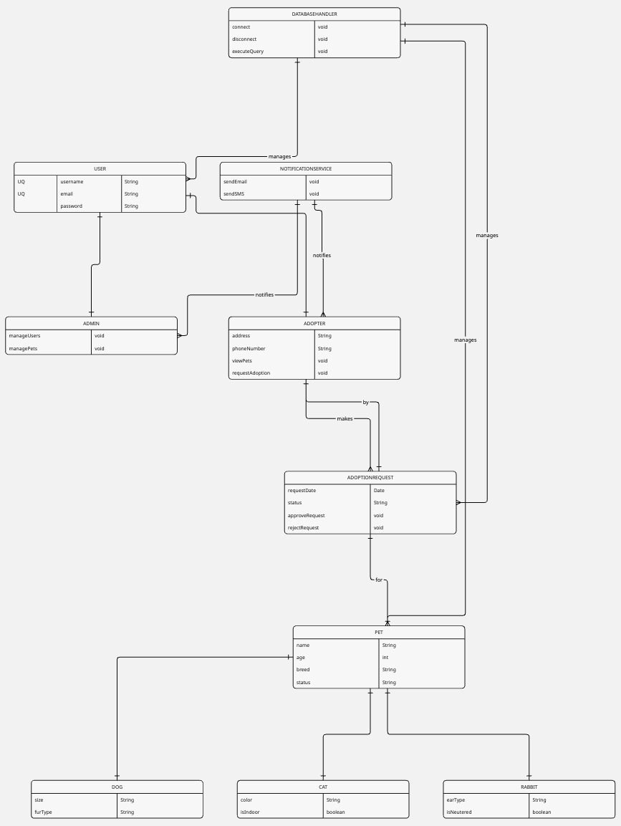
UML
Diagram

Slide 7
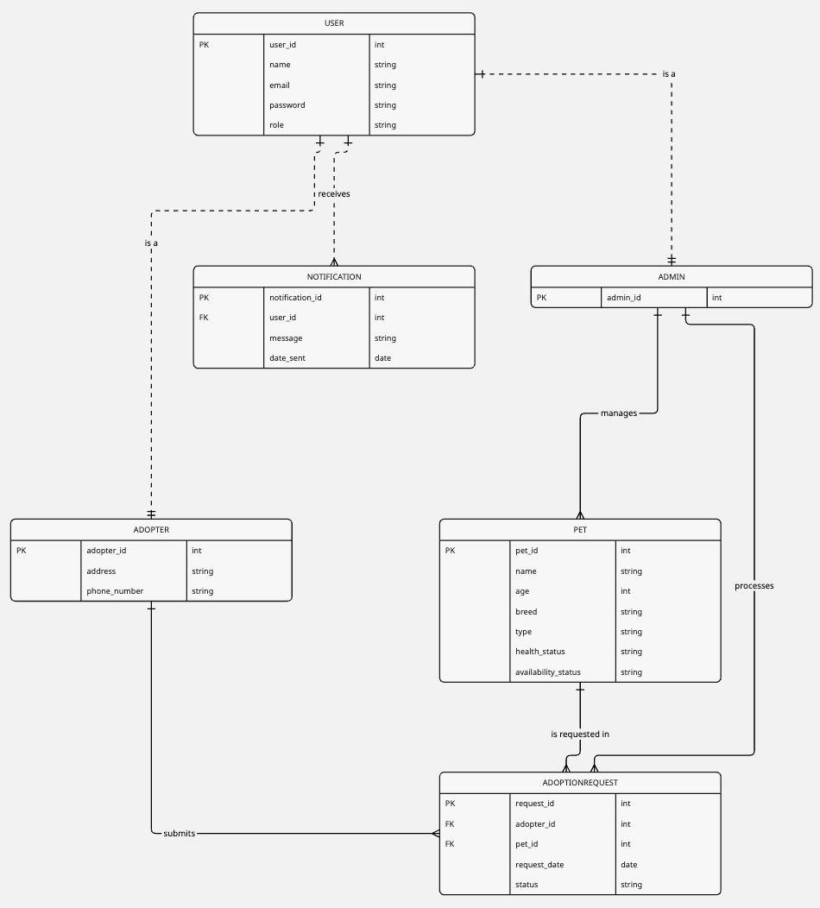
ER
Diagram

Slide 8
Milestone Summary
Milestone 1:
UML, ER Diagrams, OOP design planning
Milestone 2:
Backend logic for user/pet/request
CSV logging, controller setup
Milestone 3:
Frontend integration using React.js
Finalized login/signup flows and dashboards, exception handling, testing.

Slide 9

Future Scope
Add real-time chat between adopter and shelter
Implement authentication tokens for secure login
Add analytics dashboard for admin
Improve UI responsiveness for mobile users

Slide 10
Key Takeaways
Learned practical application of OOP and MVC pattern
Worked on end-to-end full stack development using Java
Gained experience with SpringBoot, MongoDB and React integration
Handled testing, validations, debugging and exception management

Slide 11
Project Demo
• Login and Sign Up Pages using React
• Dashboard with pet listings and request buttons
• Admin views and approves/rejects requests
• Requests and logs viewable via MongoDB/CSV
• URL: GitHub link and running demo (if applicable)

